Slide 1
CAR PRICE PREDICTION
Name: D Sravya
Role: Data Science Intern
Submitted to:
Learn and Build

Slide 2
Introduction:
In the highly competitive used car market, accurately determining the optimal pricing strategy can significantly impact a dealership's profitability and reputation. This problem aims to investigate the relationship between mileage and sale prices of cars from different brands and determine if mileage is a reliable predictor of price. Additionally, we will explore other factors beyond mileage that may influence customer willingness to pay, ensuring the dealership can set attractive prices that lead to customer satisfaction, positive feedback, and increased market presence. By leveraging expert analysis and recommendations, the dealership can achieve its goal of becoming a key player in the industry while maximizing profitability.
MOTIVATION:
Pricing accuracy: accurately pricing used cars is crucial for maximizing profitability. By understanding the relationship between mileage and sale prices, the dealership can set competitive and attractive prices that align with customer expectations and market trends.
Brand-specific insights: analyzing the slopes and intercepts for different brands allows the dealership to identify brand-specific trends in the relationship between mileage and price. This knowledge can help the dealership tailor their pricing strategy for each brand, ensuring optimal pricing decisions that reflect brand value and customer preferences.
Customer satisfaction: setting the right price is essential for customer satisfaction. By analyzing other factors that influence customer willingness to pay, such as vehicle age, condition, features, and market demand, the dealership can provide fair and competitive prices that delight customers and increase the likelihood of positive feedback and reviews.
Market positioning: accurate pricing, combined with positive customer feedback, can enhance the dealership's reputation and market positioning. By offering attractive prices that align with customer expectations, the dealership can gain traction in the market, establish a strong foothold, and become recognized as a trusted and competitive player in the used car industry.
Profitability enhancement: pricing optimization directly impacts profitability. By leveraging data analysis and expert recommendations, the dealership can identify pricing strategies that maximize profit margins without compromising customer satisfaction. This helps the dealership achieve sustainable growth, financial success, and a strong competitive advantage in the market.

Slide 3
Introduction to the data:
The data used for the problem statement includes information related to used cars sold by a specialized dealership.
The dataset consists of the following attributes for each car:
['Unnamed: 0', 'name', 'location', 'year', 'kilometers_driven', 'fuel_type', 'transmission', 'owner_type', 'mileage', 'engine', 'power', 'seats’, ‘new_price', 'price’]
The key attributes used for the prediction are:
1.Mileage
2.Kilometers_driven
3.Price
This comprehensive dataset provides valuable information that can be utilized to analyze the relationship between mileage and sale prices, as well as explore other factors such as location, year, fuel type, transmission, owner type, engine, power, seats, and new price. By leveraging this data, we can provide expert analysis and recommendations to the dealership, allowing them to set optimal prices that delight customers, generate positive feedback and reviews, increase market traction, and establish themselves as one of the key players in the industry.

Slide 4
Highlights from EDA:
Inferences:
The mean price of cars is 9.4 lakhs
The highest price is 160 lakhs
The lowest price is 0.44 lakhs
FROM THE COMPARISION WITH OTHER PATTERNS:
The price of cars is high in coimbatore and less price in kolkata and jaipur
Automatic cars have more price than manual cars.
Diesel and electric cars have almost the same price, which is maximum, and lpg cars have the lowest price
First-owner cars are higher in price, followed by a second
The third owner’s price is lesser than the fourth and above
Lamborghini brand is the highest in price
Gallardocoupe model is the highest in price
2 seater has the highest price followed by 7 seater
The latest model cars are high in price

Slide 5
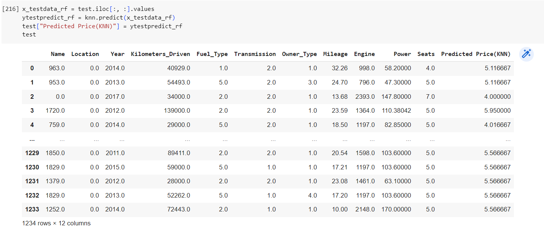
FINAL MODEL:
I made prediction with KNN model which suits best fit for the given problem statement compared to all other models
The features like kilometres_driven , fuel_type, milage, enigine playes the key role
The final output is displayed as shown below:

Slide 6
Interesting findings from the model :
Mileage as a predictor: The model confirms that mileage is indeed a good predictor of sale prices for used cars. As expected, cars with lower mileage tend to have higher sale prices, while those with higher mileage have lower sale prices. This finding reinforces the importance of considering mileage when setting prices.
Brand-specific relationships: The slopes and intercepts for mileage and price vary across different car brands. This indicates that the relationship between mileage and price differs depending on the brand. Some brands may have a steeper decline in price with increasing mileage, while others may have a more gradual decline. Understanding these brand-specific relationships can help the dealership customize pricing strategies for different brands.
Pricing optimization opportunities: By leveraging the findings from the model, the dealership can optimize their pricing strategy to maximize profitability and customer satisfaction. They can set competitive prices based on mileage, brand, and other relevant factors, attracting customers and gaining positive feedback. This will enhance the dealership's reputation, increase traction in the market, and position them as a key player in the used car industry.

Slide 7
CONCLUSION:
In conclusion, the analysis of the used car dealership's data has predicted with the KNN MODAL of valuable insights and recommendations for setting the right pricing strategy. The findings confirm that mileage is a reliable predictor of sale prices, with lower mileage generally associated with higher prices. However, it is crucial to consider brand-specific variations in the relationship between mileage and price.
FUTURE WORK:
While the current analysis focused on the relationship between mileage and price using linear regression, KNN future work could explore more advanced modeling techniques. The model could be enhanced by considering market trends and external factors that influence used car prices. Introducing customer sentiment analysis can provide insights into customer perceptions and preferences, helping to understand how certain factors impact their willingness to pay. This could involve analyzing customer reviews, feedback, or conducting surveys to gain a deeper understanding of customer satisfaction and factors influencing their purchase decisions.
THANK YOU

